Slide 1

POSITION,VELOCITY & STATIC FORCE ANALYSIS OF PLANAR MECHANISM
COMPUTATIONAL ENGINEERING MECHANICS - 2
COURSE FACULTY- Mr. Rajeevlochana G.C
Charan Tej.K
Ch.Surya Teja
Rama Sai Abhishek
AIE19013
AIE19014
AIE19054

Slide 2
MECHANISM
A mechanism is a device that transforms input forces and movement into a desired set of output forces and movement
Mechanisms tells us, how the linkages work or for what type of input , what type of output. Accordingly, we can design a machine
Examples are the steering mechanism in a car, or the winding mechanism of a wristwatch

Slide 3
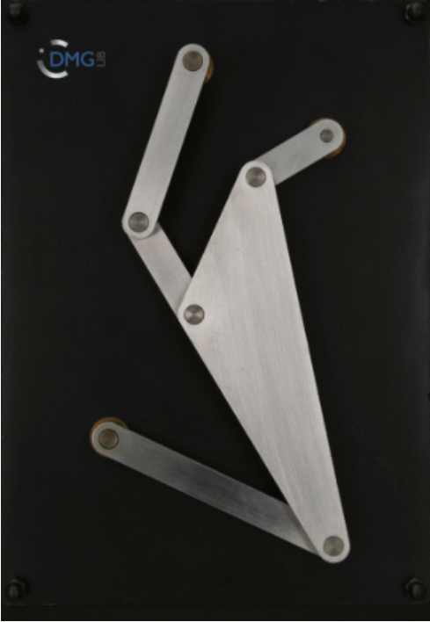
Links:
#1 is the grounded link
#2=3.49mm
#3=Ternary link
#4=10.17mm
#5=4.532mm
#6=7mm
#1
#6
#2
#1
Joints:
R12= Revolute joint connecting grounded link and link #2
R23= Revolute joint connecting link #2 and #3
R34= Revolute joint connecting link #3 and link #4
R14= Revolute joint connecting grounded link and link #4
R35= Revolute joint connecting link #3 and link #5
R56= Revolute joint connecting link #5 and link #6
R61= Revolute joint connecting link #6 and grounded link
#5
#3
#1
#4

Slide 4
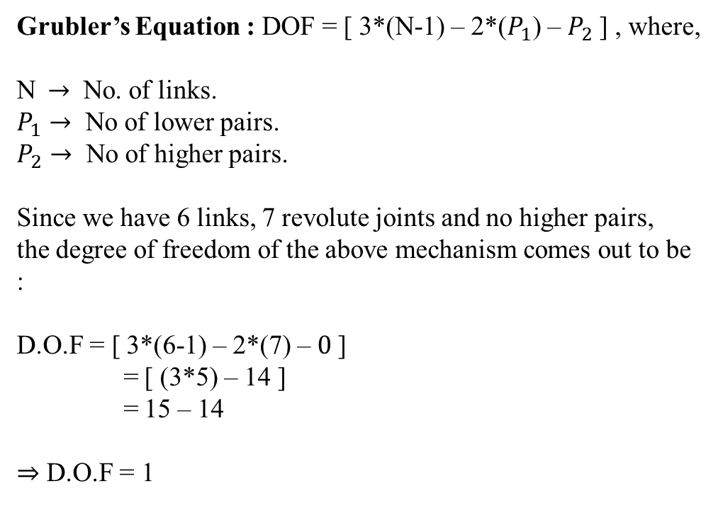
DESCRIPTION OF OUR MECHANISM
Grubler’s Equation : DOF = [ 3*(N-1) – 2*($P_{1}$) – $P_{2}$] , where,
N$→$ No. of links.
$P_{1}→$ No of lower pairs.
$P_{2}→$ No of higher pairs.
Since we have 6 links, 7 revolute joints and no higher pairs,
the degree of freedom of the above mechanism comes out to be :
D.O.F = [ 3*(6-1) – 2*(7) – $0$]
= [ (3*5) – 14 ]
= 15 – 14
⇒ D.O.F = 1
Koppelkurven – Rastgetriebe
mechanism

Slide 5
Position Analysis of Mechanism
Position Analysis of a mechanism deals with the study of orientation of the mechanism.
Gives us an insight of the constraint and moving links present in the mechanism.

Slide 6
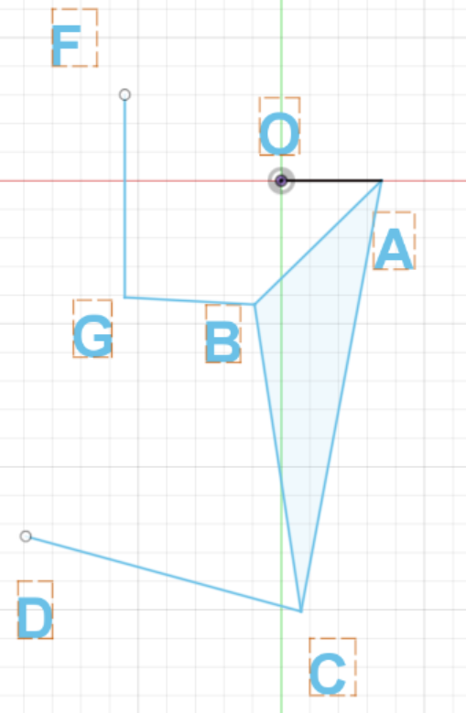
Position Analysis of Mechanism
In Fusion 360

Slide 7
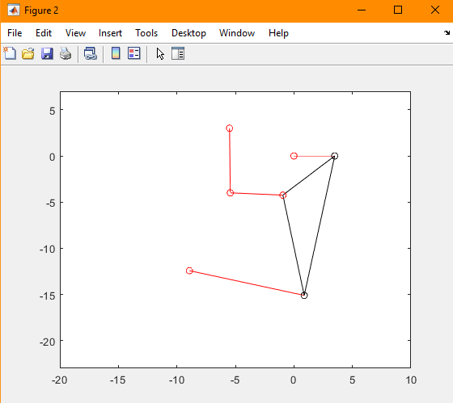
Position Analysis of Mechanism
In MATLAB

Slide 8
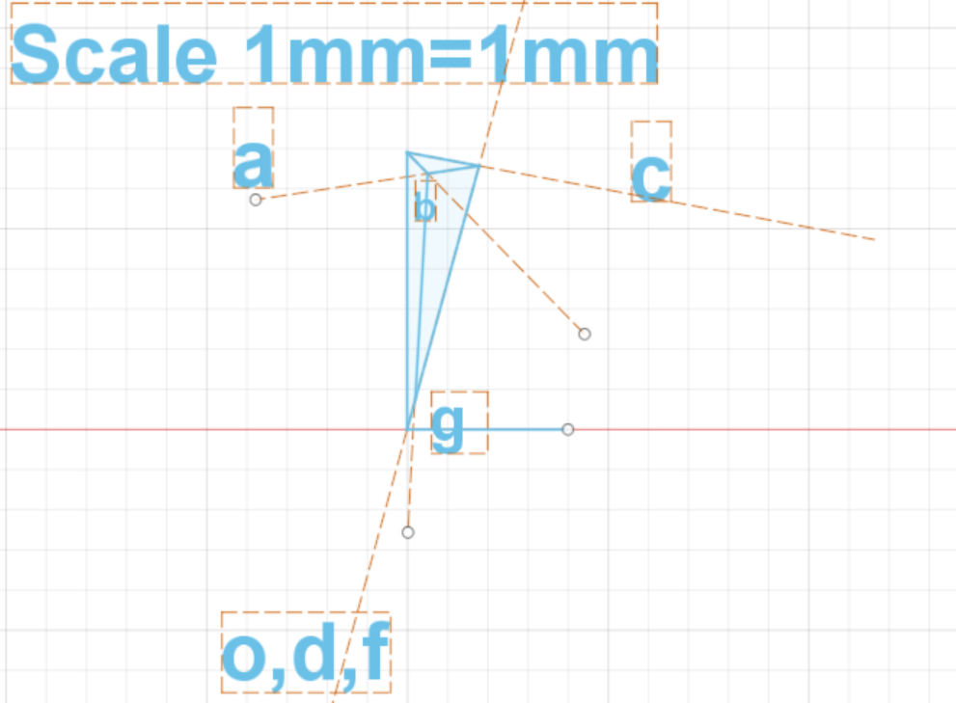
Velocity Analysis of Mechanism
In Fusion 360

Slide 9
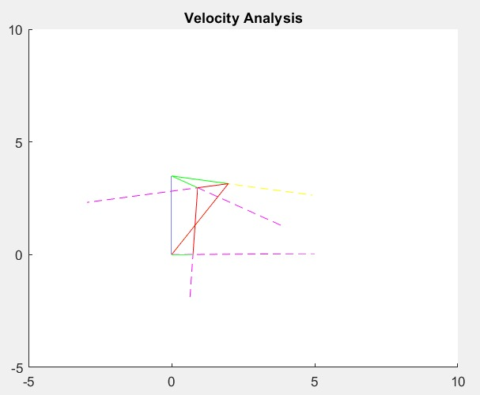
Velocity Analysis of Mechanism
In MATLAB

Slide 10
STATIC FORCE ANALYSIS
Static force analysis makes direct use of static force equilibrium equations. Here the force applied is a constant force.
For an analytical solution formulation one must draw the free-body diagram of each rigid body and must identify the unknown forces .

Slide 11
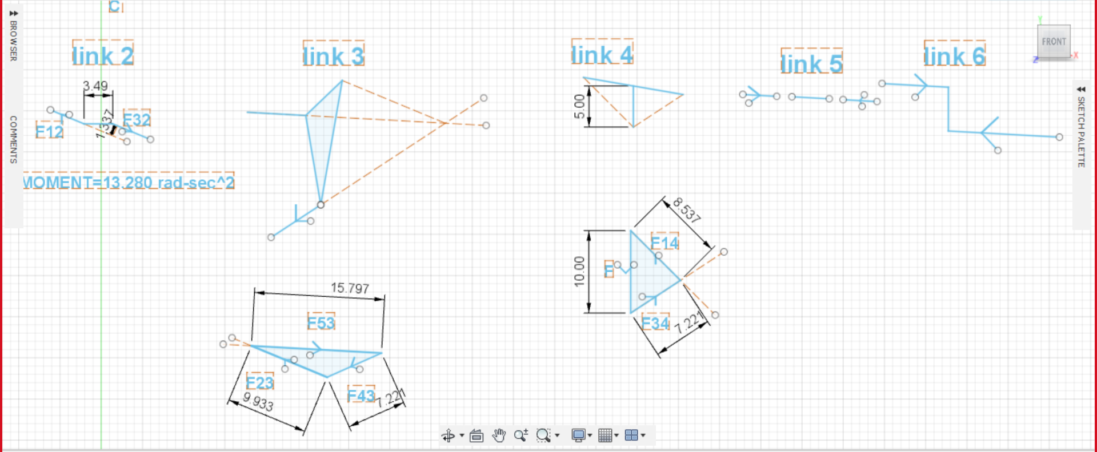
STATIC FORCE ANALYSIS
In Fusion 360

Slide 12
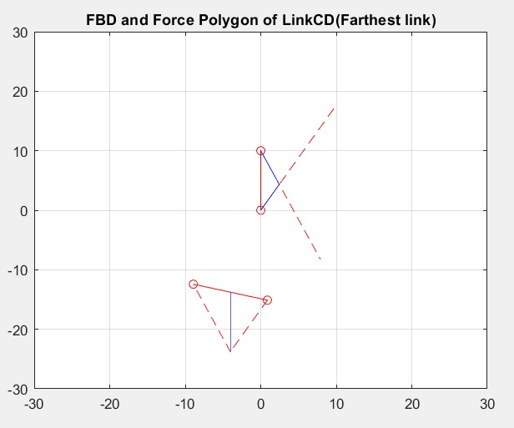
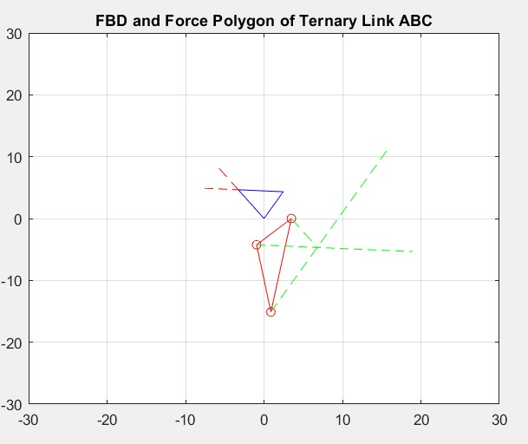
STATIC FORCE ANALYSIS
In MATLAB

Slide 13
CONCLUSION
Static force analysis helps in selecting proper size of machine components to withstand the stresses developed in them . This proper sizes are not selected ,the components may fail during the machine operations.
Position analysis is very useful in knowing the input and output position parameters and can also help in detailed understanding of different applications.
Velocity analysis involves the linear velocities of various points on different links of a mechanism which helps us to design proper models for different applications.

